Slide 1
UNIT-V
Flip Flops

Slide 2
Block diagram of Sequential Circuit
Inputs
Outputs
Combinational Circuit
Memory
Elements

Slide 3
Introduction
Digital system that include memory elements is referred as sequential logic
The memory elements are devices capable of storing binary information within them.
State – binary information stored in memory elements
Output – depend on input and present state of memory elements
Next state – function of external inputs and the present state

Slide 4
Introduction
2 types
  Synchronous
    Behavior is defined from the knowledge of its signal at discrete instants of time.
    Clock generator
  Asynchronous
    Depends upon the order in which its input signals change and can be affected at any instant of time.
    Memory elements used are time delay devices.
      Made of logic gates

Slide 5
Latch and Flip-Flop
Latches
  Operates on signal levels
    Level triggered
  Used in asynchronous sequential circuits
Flip-flop
  Operates on clock transitions
    Clock Edge triggered

Slide 6
Flip Flops
Binary cell capable of storing one bit of information.
Two outputs- one for normal and one for complement
Types:
Clocked RS flipflop
D ( data or delay) flip flop
T (Toggle) flip flop
JK flip flop

Slide 7
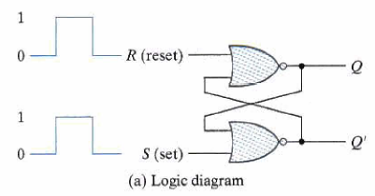
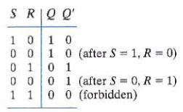
SR latch or direct coupled RS Flip-flop

Slide 8
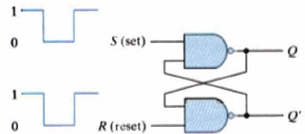
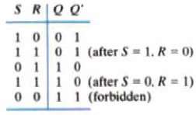
SR – Latch NAND gate

Slide 9
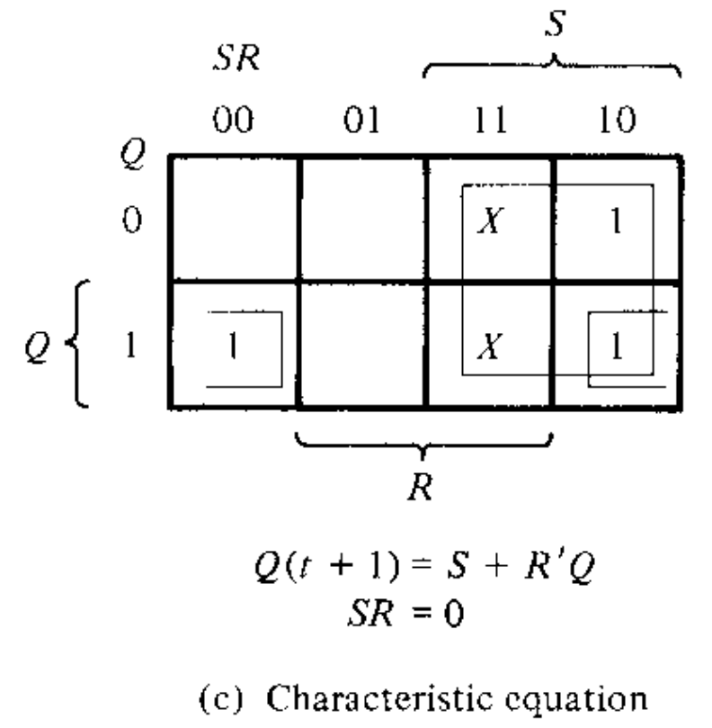
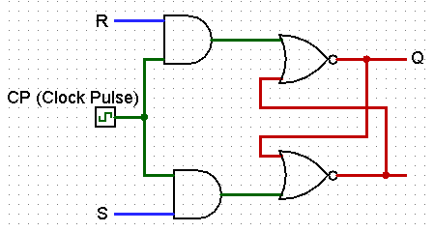
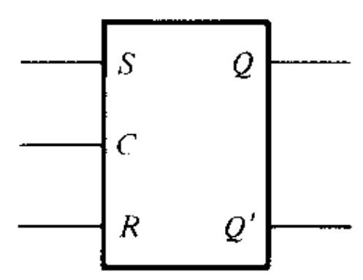
SR Flip-Flop
Q′
Q | S | R | Q(t+1)
0 | 0 | 0 | 0
0 | 0 | 1 | 0
0 | 1 | 0 | 1
0 | 1 | 1 | Indeterminate
1 | 0 | 0 | 1
1 | 0 | 1 | 0
1 | 1 | 0 | 1
1 | 1 | 1 | indeterminate

Slide 10
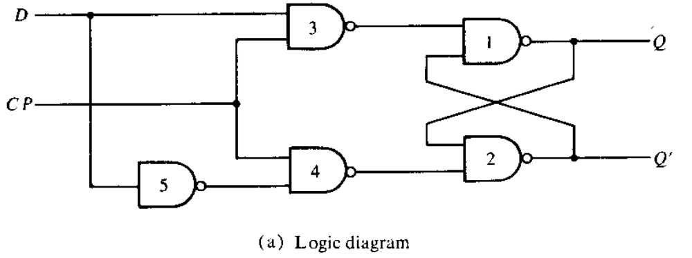
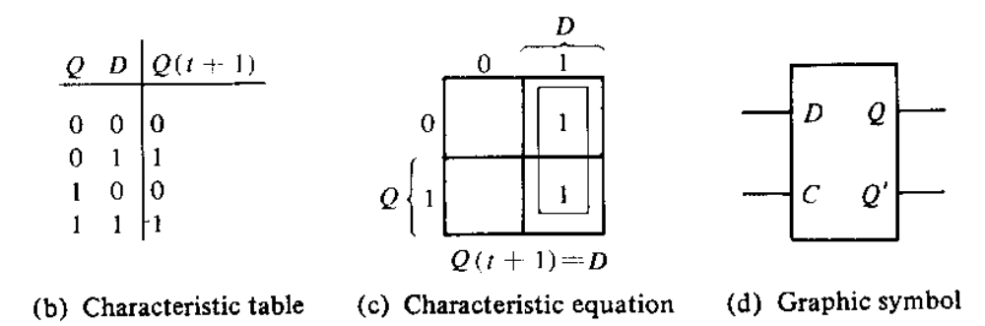
D Flip Flop/ Gated D latch

Slide 11
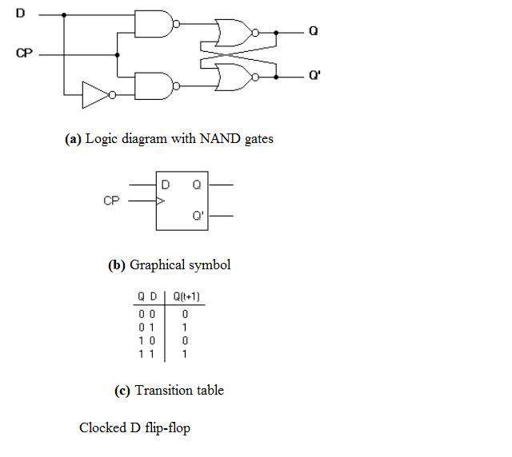
D flip Flop

Slide 12
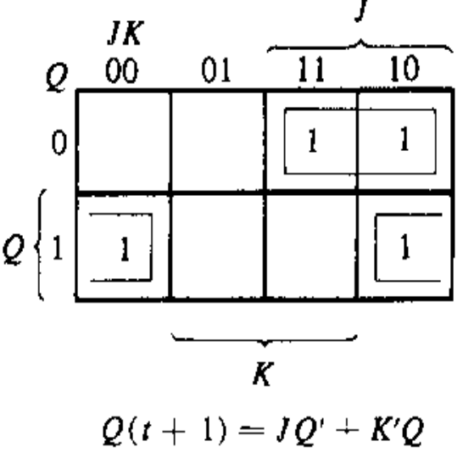
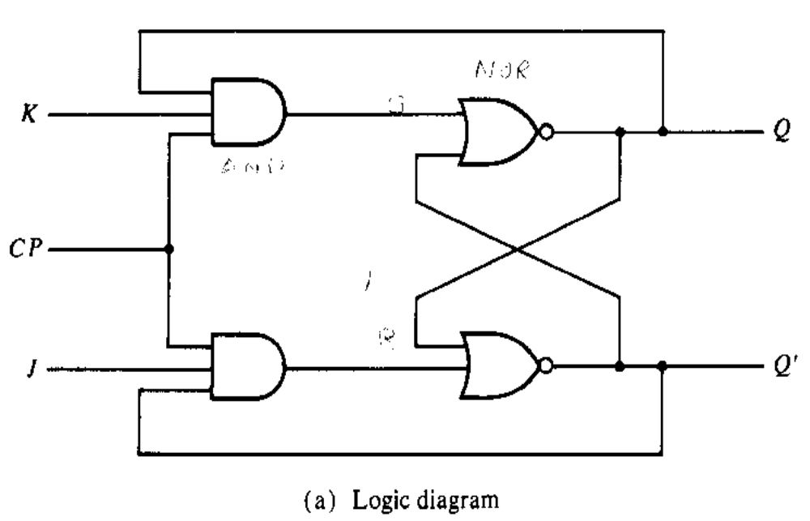
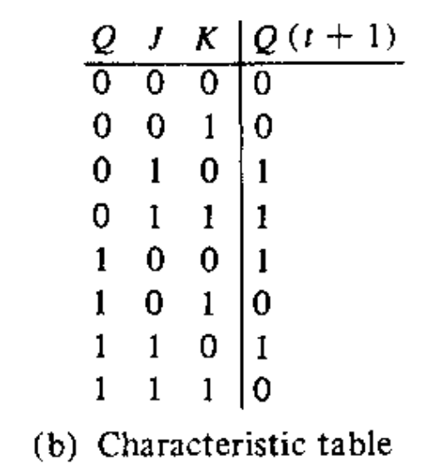
JK Flip Flop

Slide 13
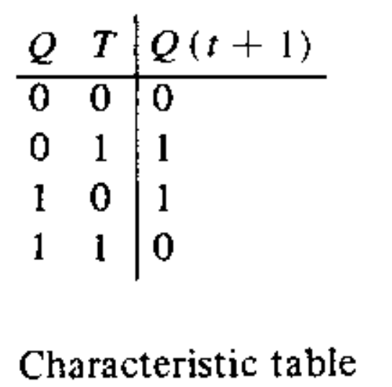
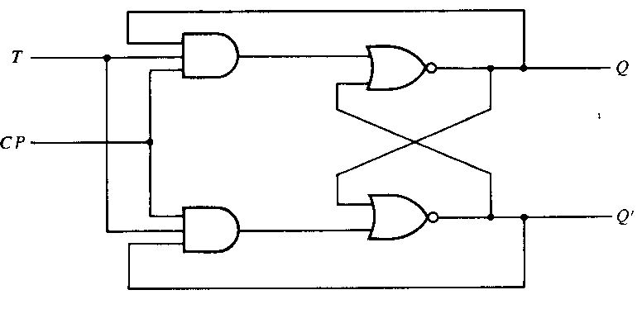
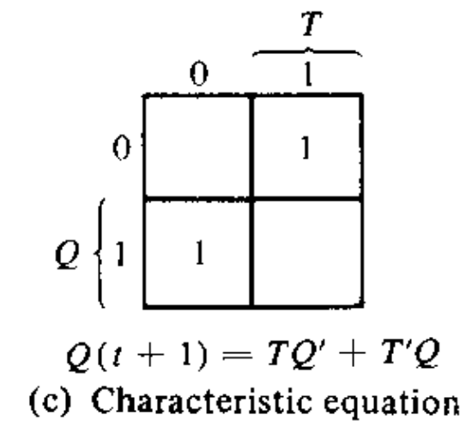
T Flip Flop

Slide 14
Triggering of Flip-flops
‘trigger’
Level triggered- asynchronous circuits
Clocked flip-flops are triggered by pulses
  Pluses- Short interval
Delay Problem
  Delay elements
  Make circuit dependent on pulse transition

Slide 15
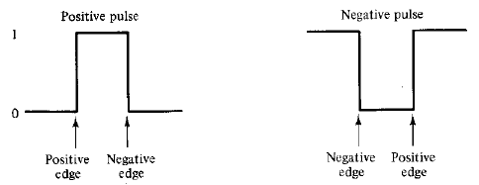
Clock Pulses
Positive and negative pulses
  Positive edge and negative edge

Slide 16
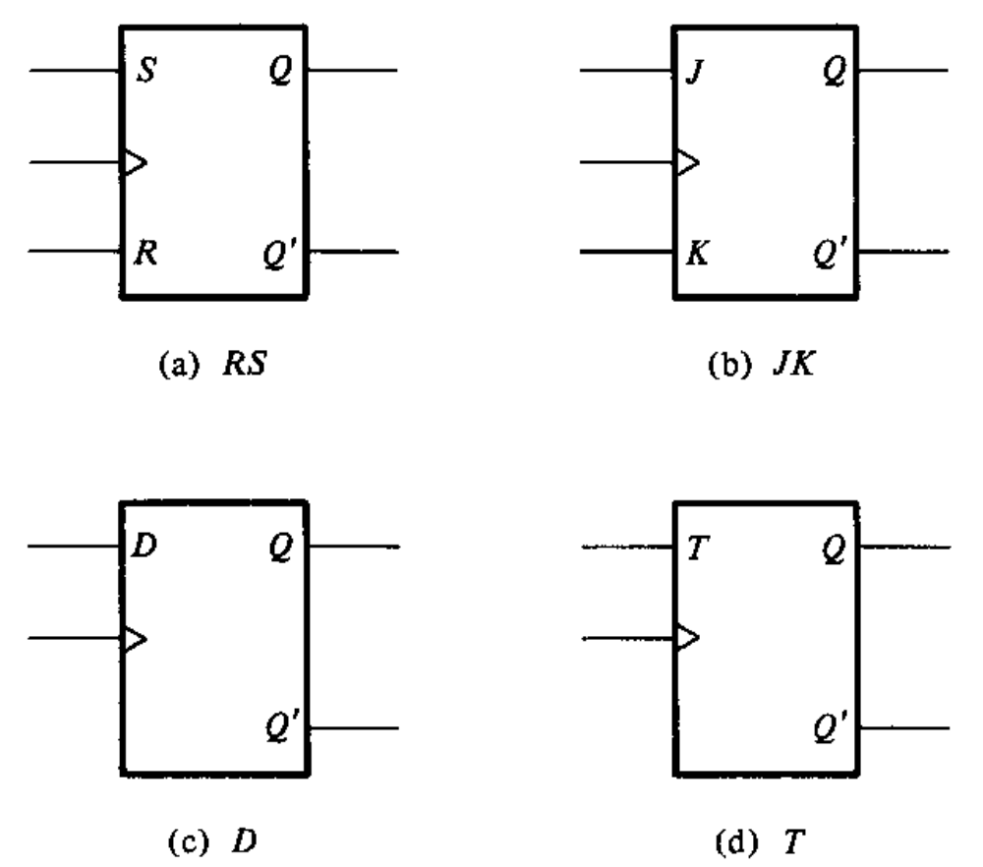
Graphic Symbols for flip-flop

Slide 17
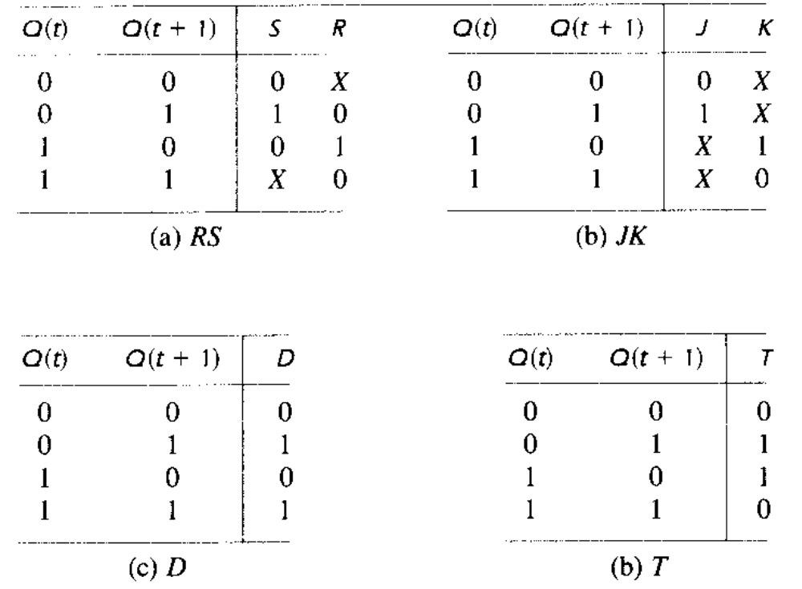
Flip – Flop Excitation Tables

Slide 18
Flip Flop conversions
http://www.circuitstoday.com/flip-flop-conversion

Slide 19
References
M. Morris Mano, “Digital Design”, 3rd Edition

